Slide 1
Program overview and course Planning
Kathleen Crook, Academic Coordinator, Trent/Fleming School of Nursing

Slide 2
agenda
Introductions
Program Overview
Electives
Course Planning and Registration
Information & Resources

Slide 3
Kathleen Crook, Academic Coordinator
Advise students with respect to program planning and goal setting
Work with students who are experiencing significant personal or academic challenges.
Provides advice or referral to more appropriate support service (i.e. faculty, financial services, academic skills, counselling services, and other on and off-campus resources)
INTRODUCTIONS

Slide 4
Our School
A diverse community of scholars and educators
Five areas of foci:
Mental health, aging, rural health, Indigenous communities, women’s health and gender
Three entry points, one curriculum:
Collaborative Program (4 Years)
Compressed Program (28 Months)
Post PN to BScN (5 Semesters)

Slide 5
Program map & Calendar
Program maps: https://www.trentu.ca/nursingorientation/program-planning-registration/program-course-maps
Page 1: Important program information & contacts
Page 2: CHECKLIST
What courses to take when
Academic Calendar
The official University document includes all requirements & important dates:
https://www.trentu.ca/registrar/academic-calendar

Slide 6
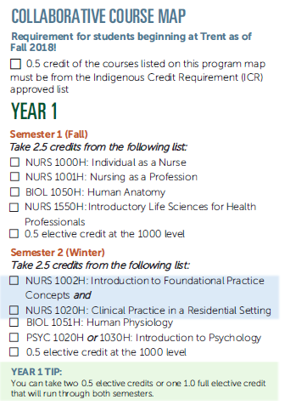
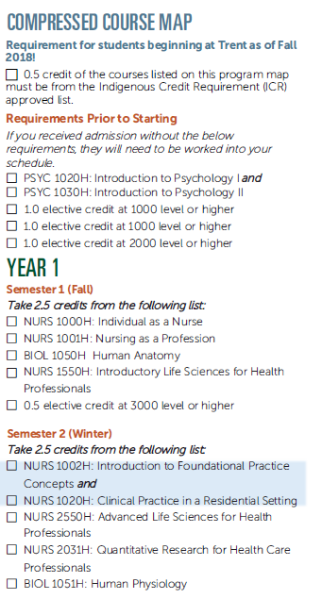
Year one Program overview

Slide 7
Decoding Course Codes
First four letter indicate the academic subject
Example: NURS = Nursing, PYSC = Psychology, etc.
The numbers identify the course and the academic level
Example: NURS 2000H = second year
NURS 3001H = third year
BScN = 20 credits
H = 0.5 credits (NURS 2000H) = Half Year or 1 Term
Y = 1.0 credits (INDG 2000Y) = Full Year or 2 Terms
C = 1.5 credits (NURS 4020C) = Clinical Course, 1 Term, 300 hours

Slide 8
ELECTIVES
4.5 credits total for the degree:
Can take electives at any time, in any order, but must be done before graduation
Compressed students: typically coming in with most or all electives complete
Check your Transfer Credits to see which you have met from the “Requirements Prior to Starting” and mapped out courses
What should I take?
What are your interests? Try something new!
Nursing Strategic Foci
Indigenous Communities, aging, mental health, rural health and women’s health and gender
Research senior level electives
ICR credit!

Slide 9
Electives
Indigenous Course Requirement (ICR)
All students pursuing a Trent degree require 0.5 credit from the Approved Indigenous Course List (ICR)
https://www.trentu.ca/indigenous/icr
Take as one of your electives (i.e. 0.5 credit at the 2000-level)
INDG 2030H, 2306H
If all your electives are complete, you still need to take an ICR credit
Forced Choice Elective
Collaborative = Year 3 semester 6
Compressed = Year 2 semester 5
PHIL 2390H - Biomedical Ethics
SOCI-WMST 2430H – Social of Gender
NURS 3560H – Advanced Pathophysiology & Pharmacology
PSYC 3560H –Family Development
PSYC 3750H – Health Psychology

Slide 10
Course Planning & Registration
Trent has priority registration, meaning the number of credits completed determines when a student can register.
Priority registration schedule posted on the timetable webpage: https://www.trentu.ca/registrar/timetable/undergraduate
Registration opens for ALL students June 26th
The TFSON will be hosting registration support zoom sessions
Links will be shared in June on Blackboard and by email

Slide 11
Transfer credits
To see what you’ve been awarded go to MyTrent > Academics > Transfer Credits icon
To be evaluated for additional transfer credit, send full course syllabi to nursingadmissions@trentu.ca
Direct transfer vs. general or unassigned transfer
PSYC 1020H direct Trent credit equivalent
ARTS YR1 general first year elective
Use transfer credit to satisfy required courses or electives. Ensure they are at the right course code and year level

Slide 12
Course Planning & Registration
Helpful how-to videos are available on the Advising website:
https://www.trentu.ca/advising/course-selection-and-registration/register-courses
Let’s look at the registration system…Self-Service

Slide 13
Course Planning & Registration Tips!
Complete required User Agreements now!
Use your Program Map as a guide when planning your schedule in Self-Service
Remember: Adding a course to your plan does not register you in the course
On your registration day a blue “Register” button will appear next to your course and “Register now” at the top of the screen
“Register now” MUST be used for winter term and any time you are in a clinical course with a co-requisite theory!

Slide 14
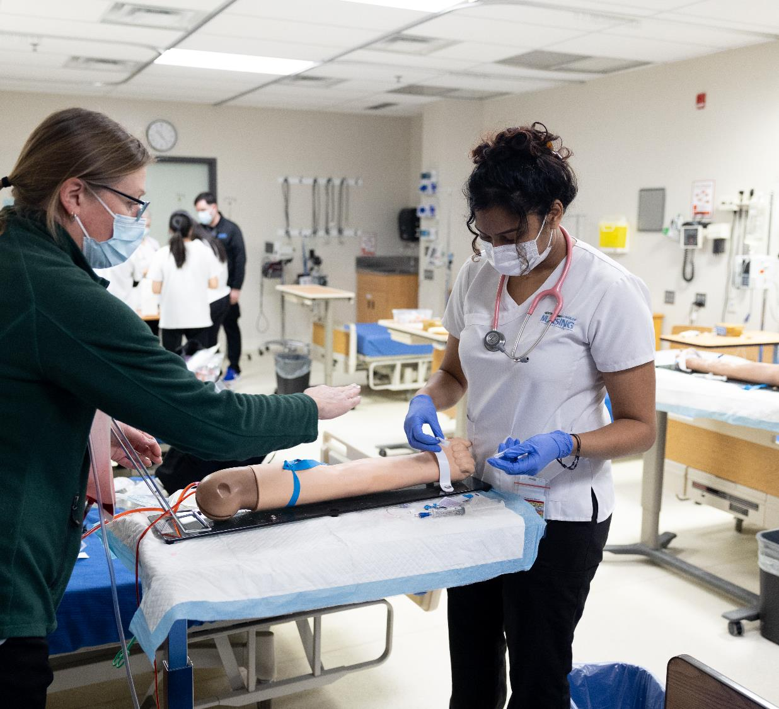
Information resources
TFSON Intranet: accessed through myTrent, Blackboard tab
Announcements, opportunities, events, reminders, etc.
Student Handbook: Available on the website
https://www.trentu.ca/nursing/student-services
Academic Calendar
https://www.trentu.ca/registrar/academic-calendar
Academic Timetable
https://www.trentu.ca/registrar/academic-timetable

Slide 15
Save the date!
Nursing Fall Orientation & Welcome
Tuesday September 3rd, 2024
Additional details will be shared prior to September

Slide 16
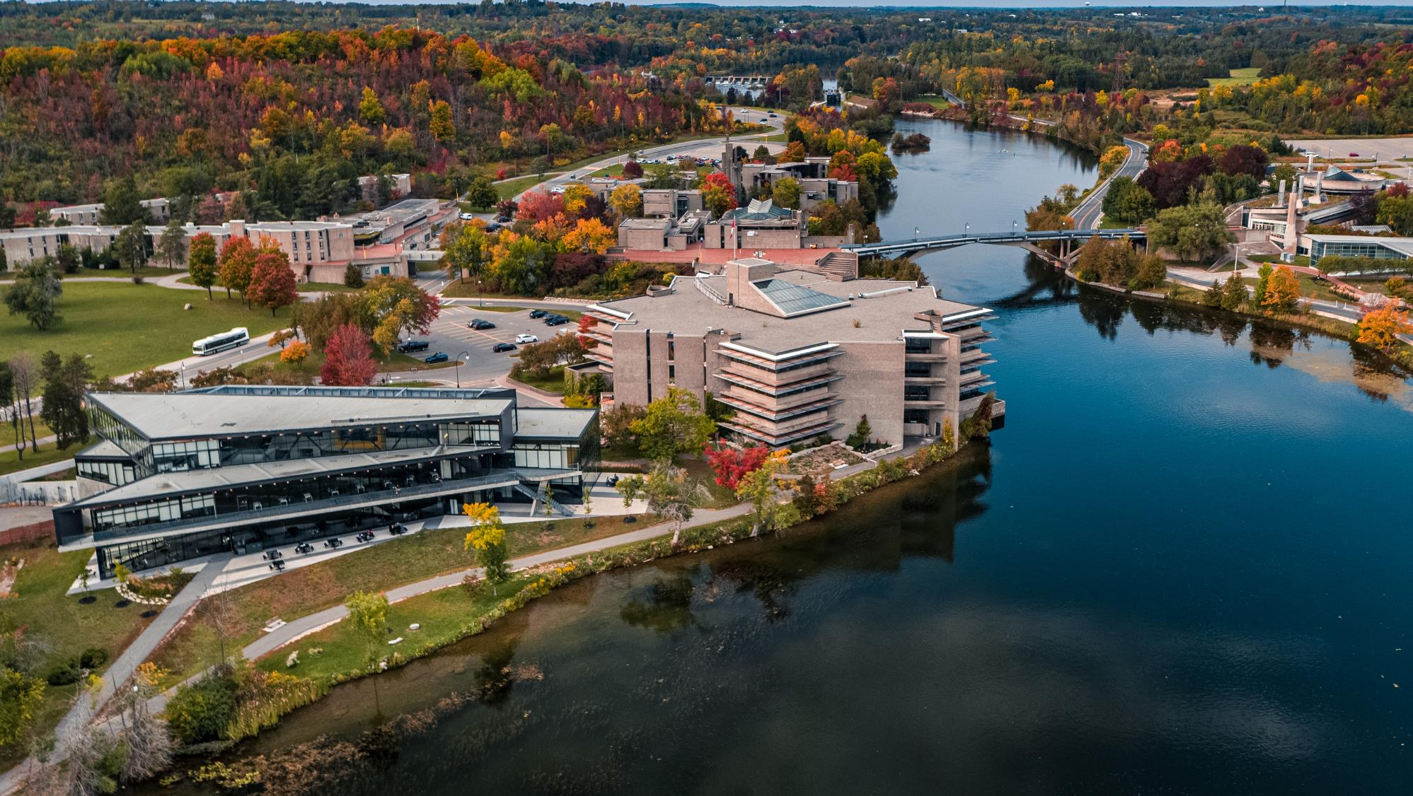
Contact Information
Advising Questions: nursingadvising@trentu.ca

