Slide 1
Funding Your Education in Nursing Fall 2024
Financial Aid
www.trentu.ca/financialaid

Slide 2
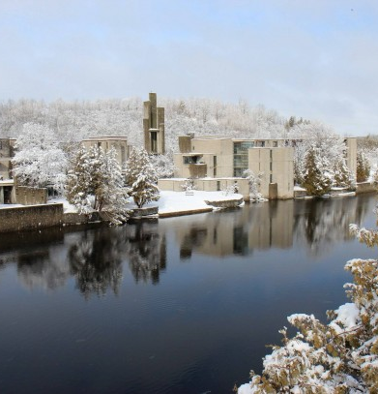
Agenda
How much does University cost?
How can I afford that?
Scholarships
Bursaries
OSAP
Other Resources
Questions?

Slide 3
How much will a year at Trent University Cost?
Expense | Amount
Tuition (billed per credit) | $6,118
Fees | $766
Books & Supplies | $2686
Total Educational Cost: *2023-2024 | $9570

Slide 4
Financial Aid Timeline
WHEN | WHAT
March – Aug. | Scholarship offers sent automatically
May | OSAP application (now!)
June – August | External awards, summer job, save money!
Sept. & Jan. | In-course Bursary Applications

Slide 5
Trent’s National Renewable Entrance Scholarships
Admission Average | Scholarship Value
80-84% | $1,000
85-89% | $1,500
90-94% | $2,500
95% + | $3,000
No application required
Based on Admissions Average
George Brown cumulative average
Renewable for years 3 and 4 at Trent
Must achieve 80% average in 5.0 Trent credits to renew

Slide 6
Bursaries
*free money from Trent!
Bursaries awarded based on financial need and require an application
Students must be in receipt of OSAP (or comparable government student assistance program) to be eligible for bursary assistance
Apply every semester you are studying (September and January & May)
MyTrent: UG Bursary Application (apply through myTrent portal under the FINANCES tab)

Slide 7
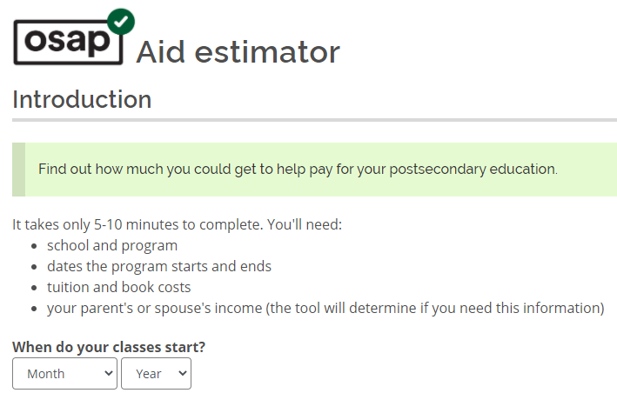
What is OSAP?
Government student assistance program for Ontario residents
Amount of funding based on several variables
Combination of Federal and Provincial Loans and Grants
= Money you keep
= Money you pay back
Ontario.ca/OSAP

Slide 8
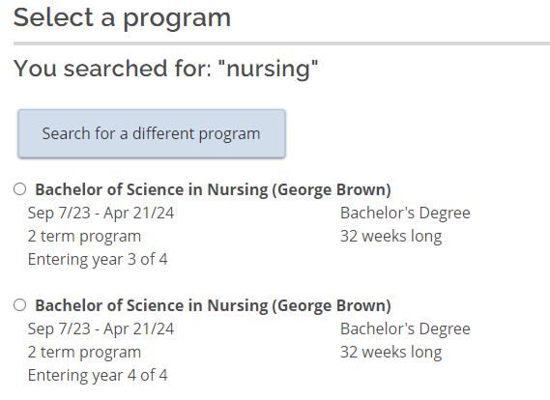
OSAP Application Steps
Sample Questions:
Where will you be living? At home/with Parents
Do you want to identify as a student with a disability?
Savings?

Slide 9
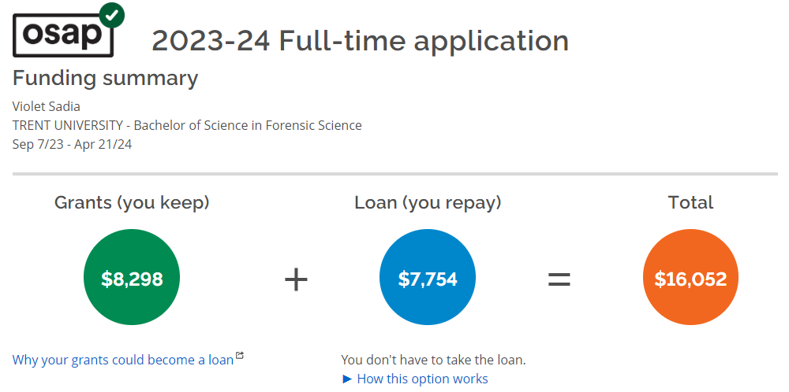
OSAP Estimated Funding
You DO NOT have to take loan – look at Funding Summary
60% of funding released in the Fall and 40% released in the Winter
Funds are automatically released to school to pay fees first
You are responsible to ensure your school fees are paid in full

Slide 10
Five things to remember!
You receive 60% of your OSAP in the fall and 40% in the winter – budget!
Any changes need to be reported to OSAP using the myTrent form – course load, income, etc.
You do not report your Trent Scholarship; We will report it for you
You must always be in at least 1.5 credits a semester (60%)*. REGISTER FOR FALL AND WINTER
You must reapply for OSAP every year

Slide 11
Other Sources and Resources
External Award Resources
RESP and personal savings
Gifts & contributions from parents/relatives
Private Loans or Student Line of Credit
If OSAP isn’t an option
Low interest rates and payments
Employment – Summer & during school year
Scholarshipscanada.com
Yconic.com
Scholartree.ca
Disabilityawards.ca

Slide 12
Summer Opportunities
Some of you might want to get a head start on your Trent degree by starting courses this summer:
If you take one half credit or two half credits over the 12 week summer session you can apply for part time summer OSAP and bursaries
If you take three or more courses during the summer you can apply for full time OSAP and bursaries with Trent as your school
** If you are a student with a permanent disability two half credits over the 12 weeks is full time

Slide 13
Thank you and welcome to Trent University!
Financial Aid Office Phone: 705-748-1524 • Email: financialaid@trentu.ca or scholarships@trentu.ca

