Slide 1
Fees & Payments
Jane Rennie
Graduate Finance Officer

Slide 2
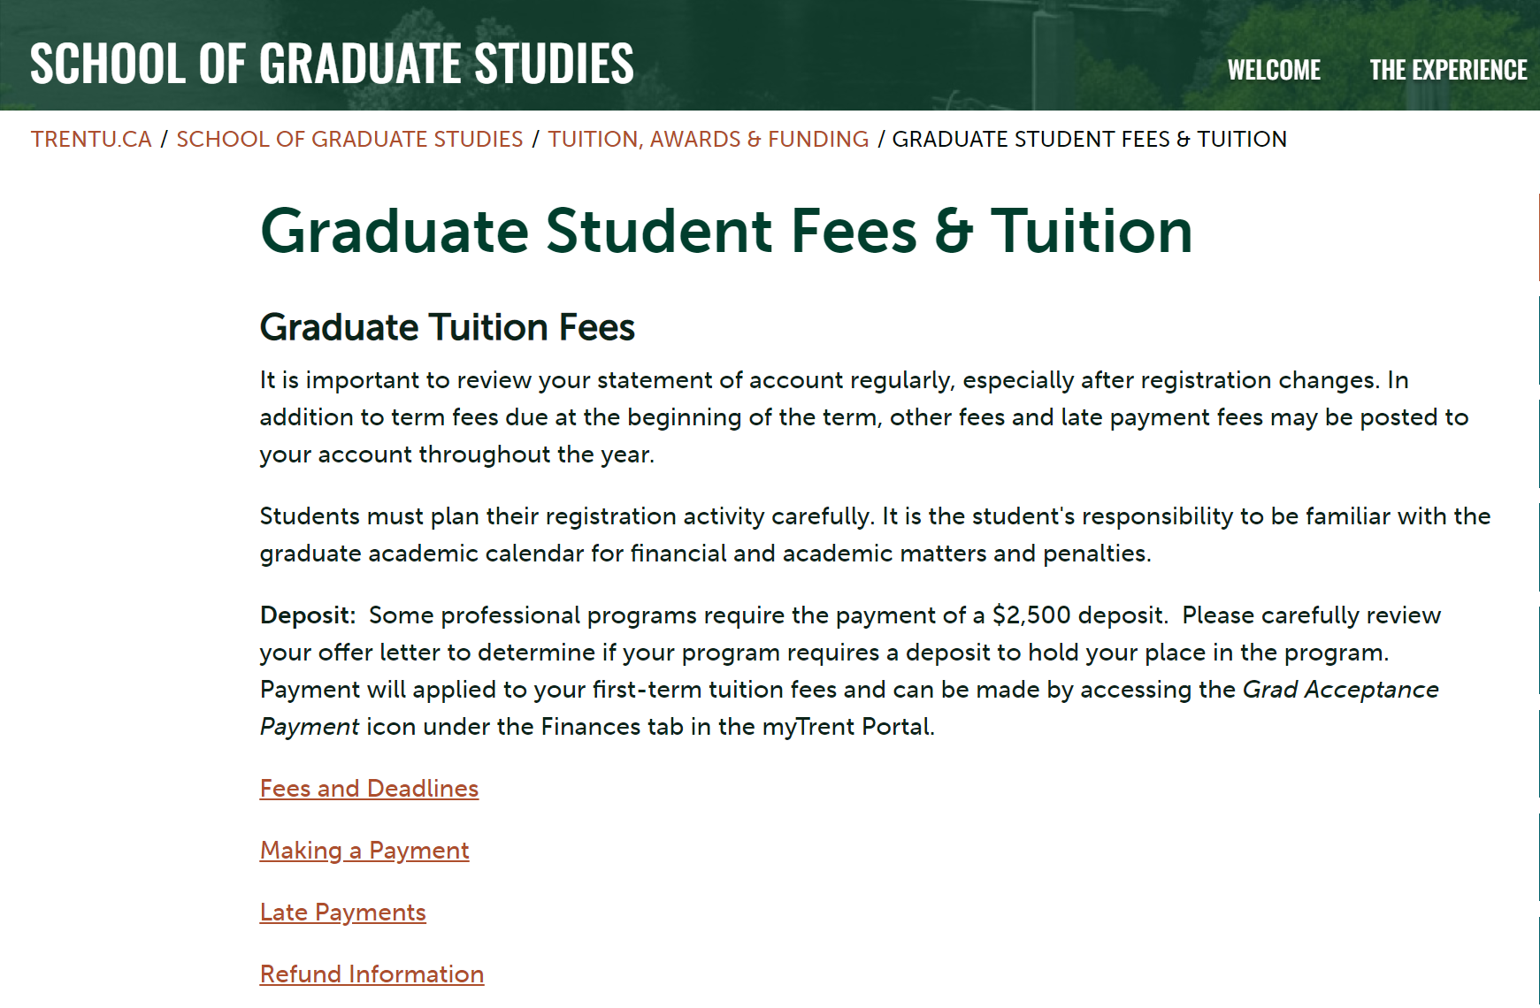
Tuition Fees

Slide 3
Fee Deadlines for Current Graduate Students
Professional Graduate Programs
September, January & May 28th
Research Graduate Programs
September, January & May 28th
Graduate tuition fees vary between research/thesis-based programs and professional programs. Students are responsible to refer to the fee deadlines schedule.
Fees for graduate studies are billed per term or per course (programs vary) and fees are based upon year of entry into a graduate program at Trent University.
Please review the Graduate Academic Calendar for further information.

Slide 4
Your Student Account
Your student account is maintained by the University's secure student system. It is where we charge all your fees and your payments are received. It is important to review your statement of account regularly, especially after any change of status or term registration.
All students must register and pay fees at the beginning of their program of study and must maintain continuous registration and fee payment (except during approved leaves) until degree requirements have been completed and notification of approval to convocate has been received.
A $75 late payment fee will be levied if payment is not made by any fee payment deadline date for any academic term.
Your account statement is available on the myTrent portal:
myTrent>Finances>My Account>Account Statement
Notes:
Students are encouraged to review the graduate calendar with regards to fees, at School of Graduate Studies policies, can be found starting on page 116 of 2020-21 Academic Calendar
Tuition for graduate studies is applied three times a year and is typically posted to your student account the week prior to a new term. Billing is triggered by registration in the holder course GSFT 500. Registration fees are applied three times a year.
Ancillary charges are non refundable.

Slide 5
Health & Dental Benefits
Heath and Dental charges are billed in full in September for students enrolled in September and in January for students starting their graduate program in the winter term.
The plan is compulsory for graduate students.
Opting-Out: Peterborough full-time and Durham students are automatically enrolled in and billed for Health and Dental plans. If you already have coverage through another plan, you may submit an online request to opt-out through (TCSA).
The last day to opt out of health benefits is September 30th each year.
For more information about opting in or out, as well as plan coverage contact the Trent Central Student Association (TCSA) at 705-748-1000 or benefits@trentcentral.ca
Also visit Student VIP’s website.
Notes:
Click on the links to find out the fees for your program.

Slide 6
MyTrent>Finances>My Account>Account Statement

Slide 7
Making a Payment:
Your Student Account & How to Pay
Registered Students Payment Methods
Pre-Authorized Debit (for domestic students)
Credit Card via PayPath (for all students)
TransferMate (for international students)
Payment Plans (for all students)
For More Information: https://www.trentu.ca/studentfinances/tuition-fees/making-payment

Slide 8
Making a Payment:
Your Student Account & How to Pay
Applicants & Offer Accepted Students Payment Methods
Until you become a registered student you will not be able to fully access the Student Account Payment Center
International students with “Applicant Status” and or who have not yet commenced their program of study, follow finance bill payment instructions per TransferMate
Domestic students who are classified as an applicant, have been offered admission, or accepted an offer, these students can pay through online banking, cheque, money order, debit card in the Student Accounts Office or they can pay at the teller at their bank.
For More Information: https://www.trentu.ca/studentfinances/tuition-fees/making-payment

Slide 9
Additional Living Expenses
It is essential as a graduate student that you have sufficient funds to support yourself over the duration of your studies. Current annual costs for a graduate student living away from home including living expenses and books are estimated at $20,000 - $25,000 per year – this does not include tuition fees. Additional costs may be incurred depending on factors such as lifestyle and the number of family members supported.
In addition to living expenses, students are required to pay tuition fees for each term of enrollment.

