Slide 1

Graduate Student Tuition & Fees
AND
Graduate Accounts & Funding 2025-26
Jane Rennie
Graduate Finance Officer
School of Graduate Studies

Slide 2

Land Acknowledgement
“We respectfully acknowledge that we are on the treaty and traditional territory of the Michi Saagiig Anishinaabeg.
We offer our gratitude to the First Peoples for their care for, and teachings about, our earth and our relations. May we honour those teachings.”

Slide 3
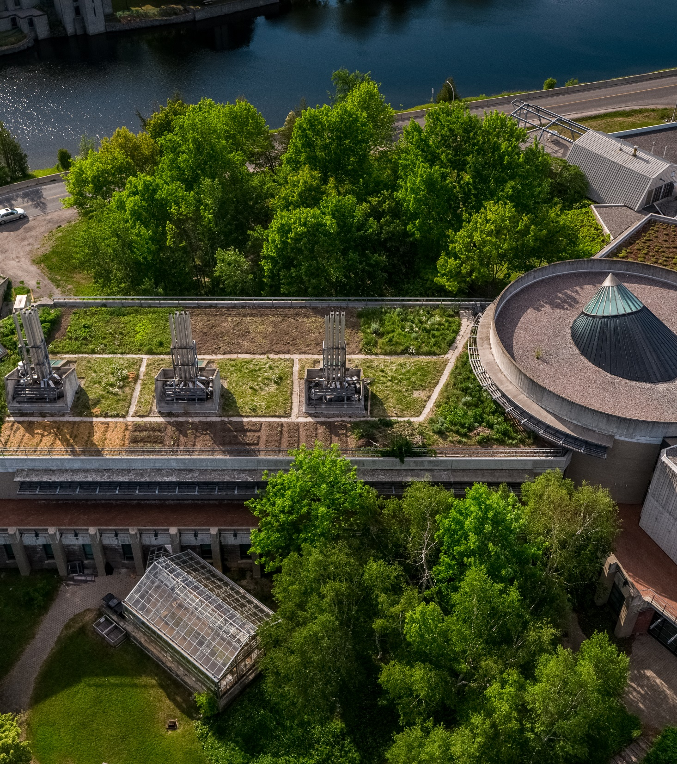
Graduate Tuition Fees
Graduate tuition fees vary between research/thesis-based programs and professional programs.
For full details on graduate fees for the 2025-2026 academic year, please refer to the appropriate fee schedule.
Fees are subject to approval by the Trent University Board of Governors and the yearly fee schedule is posted by end of July of each academic year.
Fees for graduate studies are billed per term or per course (programs vary) and fees are based upon year of entry into a graduate program at Trent University.
Tuition fees may increase each academic year.
Trent’s academic year runs from September to August. The updated tuition fees for the upcoming academic year are published on our website each July.

Slide 4
Student Accounts &
Tuition
Graduate Tuition Fee Deadlines
Fall Term: September 28, 2025
Winter Term: January 28, 2026
Summer Term: May 28, 2026
You must be registered in your program’s placeholder for your tuition billing to be applied to your student account.
Billing is applied 2-3 weeks prior to the start of a new term.
You can view your tuition in the myTrent portal:
myTrent > Finance > My Account > Account Statement.
Please check your program’s 2025-26 tuition fees before the start of term, as they have increased beyond the estimate provided in your admission letter.
It is important to review your student account regularly, especially after registration changes.

Slide 5

Tuition Payments
Payment options are divided into categories. Select the category that best suits your financial scenario on the Making a Payment webpage.
Payment Methods for Registered students
Payment Methods for Applicants & for Students who have Accepted their Offer of Admissions
Making a Successful Convera Payment
Payments Methods for Students Receiving OSAP
Payment Methods for Third Party Sponsored Students
Payment Methods for Inactive Students
Important Information related to student payments

Slide 6
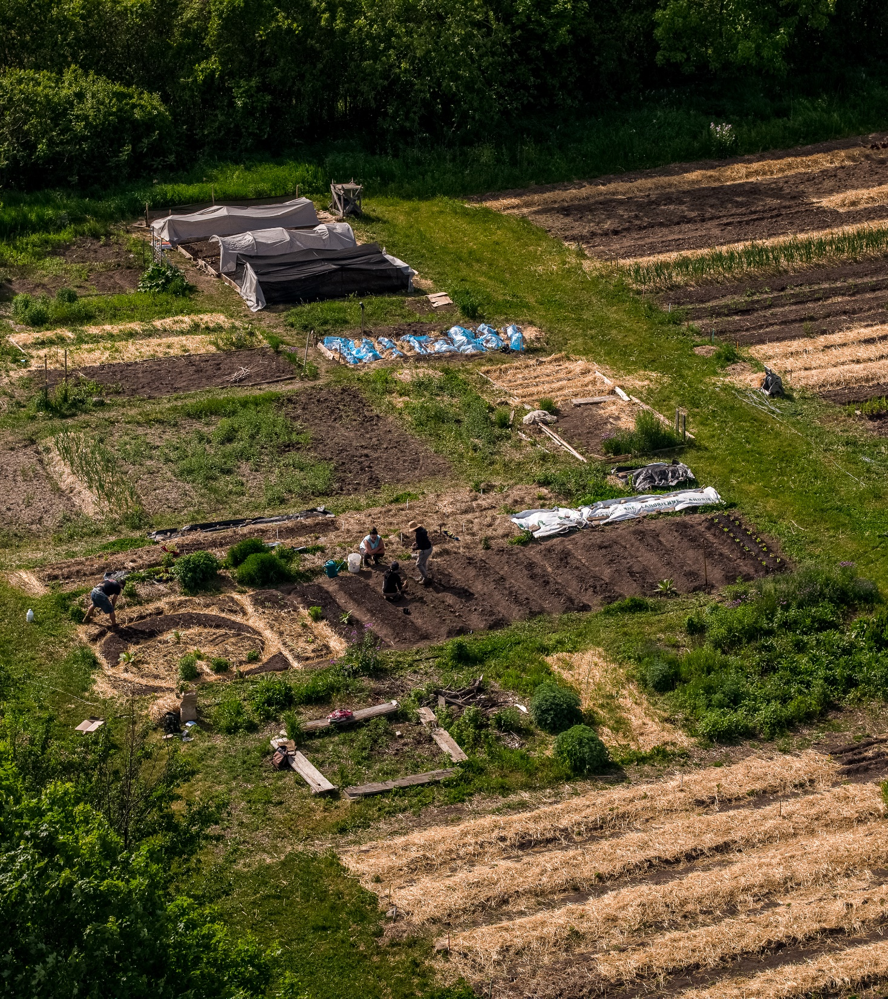
Important Additional Information
Financing with Private Lenders – Important Process Information
While students may opt to seek financing for their education through private lenders, please be aware that Trent University will not issue refunds greater than the student's Trent-related expenses (tuition, ancillary fees, meal plans, and ON-campus housing).
Students who are borrowing funds to pay for OFF-campus housing and other living expenses should arrange for funds to be deposited directly into their personal bank account.
Late Fees and Returned / Declined Payments
It is the student's responsibility to ensure that their payment(s) are received by the Student Accounts Office on or before the due date(s).
A late charge of $100.00 is applied to all accounts with a late payment and interest will accrue. An additional fee of $40 will be charged for all returned payments.
To avoid monthly interest charges, please ensure your account balance is paid in full. Outstanding balances are subject to monthly interest.

Slide 7

Payment Plans
Payment Plans are a type of financial arrangement that will allow students to make periodic payments towards tuition fees. This opportunity provides a convenient way to pay fees with more management payments.
Graduate students can apply for a payment plan at the beginning of each term (September, January, and May).
Please visit Student Finance's payment plan webpage for more information.
Questions: campuspayment@trentu.ca
There is an enrollment fee of $150 for each graduate plan.

Slide 8

Scams in Canada
Scams can happen to any student, but international students are especially at risk because they are new to Canada.
Scammers often try to scare students by pretending to be from the government and threatening deportation.
Remember: No real employer, government agency, or police will ask you to send money by phone or email or threaten you.​
If a message feels strange or scary, don’t respond – ask someone at Trent International, the School of Graduate Studies or Trent Security for help.
If you are victim of a scam:
Contact local police
File a report with Canadian Anti-Fraud Centre (1-888-495-8501)
Share your story with others
Contact Trent International for guidance, and advise other relevant uuniversity departments such as Housing, Student Accounts, or the School of Graduate Studies.
Notes:
https://www.trentu.ca/graduatestudies/financial-matters/student-account-and-tuition

Slide 9
Health & Dental Benefits
Health & Dental Benefits
Opting-Out: Peterborough full-time and Durham students are automatically enrolled in and billed for Health and Dental plans.
If you already have coverage through your parent’s plan or personal employment, you may submit an online request to opt-out through the Trent Central Student Association (TCSA).
Students who complete a valid opt-out, will receive their refund as arranged by the association after the start of the term.
Please visit this website for more information.
Questions?
Trent Central Student Association (TCSA) - Peterborough students
Call 705-748-1000 or visit www.trentcentral.ca
Opt-Out Deadlines Apply:
September 1 - September 30 (September-start students)
January 1 - January 31 (January-start students)
For more information about opting in or out, as well as plan coverage, visit https://www.studentvip.ca/Default.aspx
Notes:
https://www.trentu.ca/graduatestudies/financial-matters/student-account-and-tuition

Slide 10

Graduate Student Accounts
&
Graduate Funding

Slide 11

Admissions Letter:
Total financial support
Keep your offer of admission letter as it includes valuable financial information
Review your Graduate Student Funding outline which is the second page of your Offer of Admission for:
Source of funding (name)
Years offered
Total Funding Support
Additional Information about your Funding – an important section as it elaborates on your funding and university processes and policies
Notes:
To submit questions about your student account you must communicate using your Trent University email account.

Slide 12
Graduate Teaching Assistantships (GTA)
Graduate Teaching Assistantship (GTA) is a form of employment. Full-time graduate students assigned a GTA must be available to work on campus during the period of employment.
Students are encouraged to review the website for detailed information.
Trent University and the Ontario Council on Graduate Studies are committed to the principle that full-time graduate students are employed no more than an average of 10 hours per week.
GTAs are processed bi-weekly through Payroll as an electronic funds transfer directly to your personal bank account between September and April.
On the Graduate Student Funding page of your Offer of Admission, the department that you have been assigned to is provided along with the terms you have been approved to hold a GTA.
For further information on GTA’s email: gradta@trentu.ca

Slide 13

Funds posted to Student Account
Graduate Research Fellowships (M & D)
SGS Academic Scholarship
SGS Research Fellowship Award
Dean’s PhD Scholarship
International Graduate Scholarship
Entrance scholarships
These types of funds are posted to student accounts by the end of the third week of the first month of each academic term.

Slide 14

Entrance Scholarships
All entrance awards with a value of $3,000 or less, are posted to the student account during a student’s first academic year. Entrance scholarships are a form of graduate funding, which is posted to student accounts by the end of the third week of the first month of the academic term.
Entrance awards of $3,000 or more: the first $3,000 is posted during the first month of the academic year, and the remainder is split between the second and third term, unless otherwise outlines on your Graduate Student Funding page.
These funds are posted to student accounts by the end of the third week of the first month of each academic term.

Slide 15

Research Fellowship Awards (RFA)
RFA support comes from a student’s Supervisor.
Generally, this type of funding is for students in science graduate programs. Review your “Graduate Student Funding” page within your offer of admission for the value of this support.
Payment distribution typically consists of smaller amounts in fall and winter, with final payout in spring term. The distribution should be discussed with your Supervisor.
Supervisor will email the Graduate Funding Form 1B to graduatefinance@trentu.ca prior to September 10th, January 10th, or May 10th.
The Finance Team receives and processes funding forms, sending a complete listing to the Office of Research & Innovation, who review and approve Supervisor RFA support.
The Finance Team is advised that the approval process has been completed and RFA funding is posted to a student’s account.

Slide 16
External Scholarships
Primary External Scholarships at Trent:
Tri-Council’s Canada Graduate Research Scholarship – Doctoral Program
Tri-Council Canada Graduate Research Scholarship – Master’s Program
Ontario Graduate Scholarship & Queen Elizabeth II Ontario Graduate Scholarship in Science & Technology
These funds are posted to student accounts by the end of the third week of the first month of each academic term.
Students submit a credit refund request form for the funds to be moved to a student's personal bank account.

Slide 17

Bursary Support for Financial Need
The general bursary program for graduate students at Trent University is administered by the Financial Aid for domestic and international graduate students. Many students need some form of financial assistance to achieve their academic goals.
The application is available, at the beginning of each term:
myTrent > Finance > Financial Aid
Online Application Deadlines
Fall Deadline: September 30, 2025
Winter Deadline: January 31, 2026
Spring Deadline: May 24, 2026

Slide 18
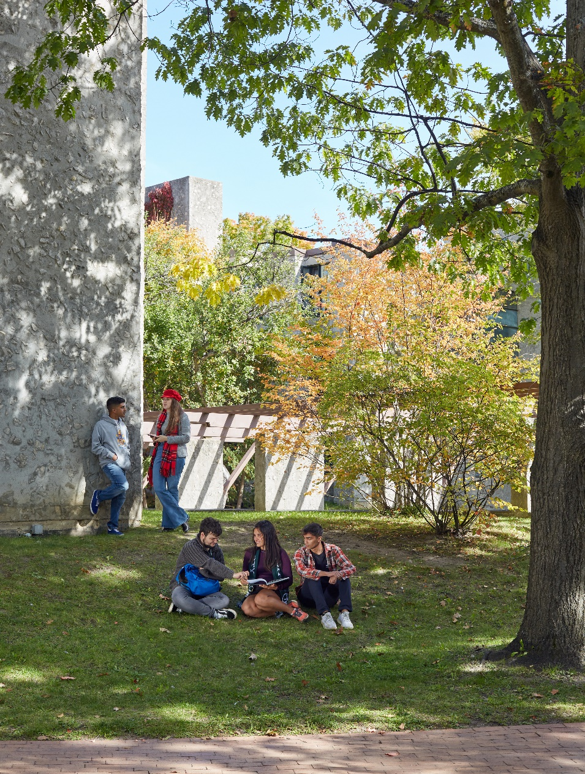
Refund Information
A credit balance occurs when you have more funds in your account than what has been billed or charged to your account.
It is important to review your student account regularly. You can find your account statement online in the myTrent portal:
myTrent > Finances > My Account > Account Statement
There are various scenarios that creates a credit balance in your student account. It is important to understand how the credit balance is created to determine which area within the university is responsible to process your credit refund.

Slide 19
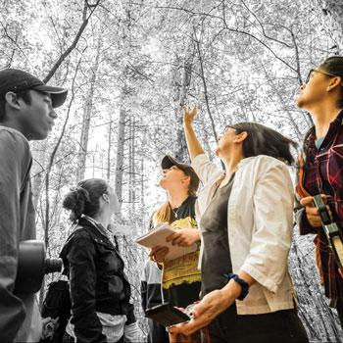

Student Refunds: Bursaries & Financial Aid
Defined: Students eligible for this type of refund have received provincial government financial aid and or have received a graduate domestic or international bursary.
These types of requests are processed by the Financial Aid Office.
The refund request form is found on the myTrent portal:
myTrent > Finances > Financial Aid > Financial Aid Refund Request
For further questions contact: financialaid@trentu.ca

Slide 20
Student Refunds: Refunding Credit on student Account
Reason for a credit balance:
Graduate funding
External scholarships
Tuition overpayment
External loan cost of living allowance
These types of requests are processed by the School of Graduate Studies.
The refund request form is found on the myTrent portal:
myTrent > Finances > Financial Aid > Graduate Refund Request (Credit on Account)
For further details contact: graduatefinance@trentu.ca

Slide 21
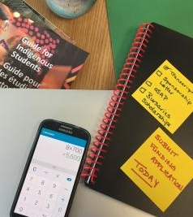
Finance Connections Around Campus
The Financial Aid Office at Trent processes Ontario Student Assistance Program (OSAP) applications for graduate students, as well as assists with the facilitation of the graduate bursary application. While OSAP is only available to Ontario students, both international and domestic students are welcome to apply for a bursary.
Graduate Studies & OSAP
As a graduate student you are eligible to apply and receive OSAP funding.
OSAP for graduate students is processed each term. Allowing OSAP recipients to receive a disbursement each term they are eligible.
For more information about OSAP as a graduate student review the Financial Aid Office materials posted for graduate students, not undergraduate students.

Slide 22
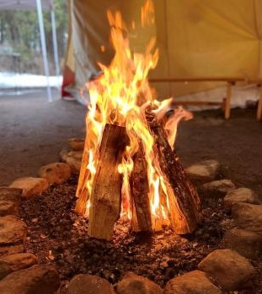
Indigenous Student Financials
First Peoples House of Learning (FPHL) offers cultural services to a diverse community of Indigenous learners (First Nations, Status/Non-Status, Métis, and Inuit).
They collaborate with students to support their academic success, personal development and leadership potential.
In addition to their student students, FPHL provides information on financial opportunities for Indigenous students. Check out the FPHL Financial Assistance page for more information.
If you have any questions or concerns about financial matters, please contact the Indigenous Student Success Coordinator at fphlstudentsuccess@trentu.ca or (705) 748 1011 extension 7358. You can also directly Book a Meeting.

Slide 23
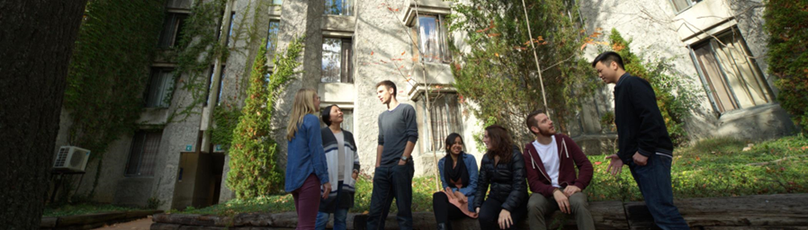
How to Win Scholarships
Upcoming workshops & Events
Scholarship Application Resources
Winning graduate scholarships takes practice. The School of Graduate Studies is hosting a series of workshops to guide you through the scholarship application process. From crafting an impactful outline of proposed research to navigating special circumstances, these workshops aim to equip you with the tools you need.
All workshop slide decks are posted to this site, and they are a helpful resource.

Slide 24
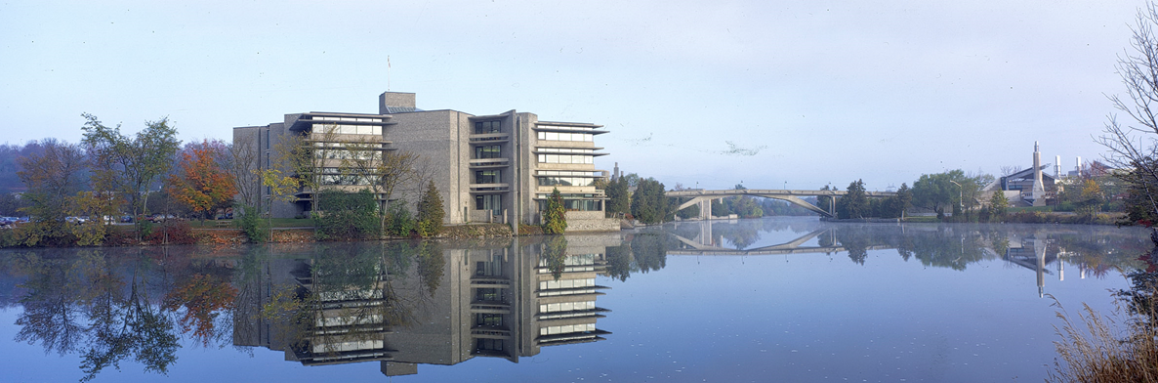
School of Graduate Studies
Blackburn Hall, Suite 115
All financial inquires direct to: graduatefinance@trentu.ca

